Slide 1
LEGO Robotics Exam Review

Slide 2
Question 1
This block is a :
display loop
move sound
switch wait
motor

Slide 3
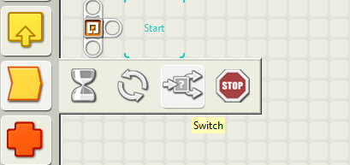
Oops!
This block is used to create conditional statements:
IF I had got this right
THEN I would have gone to the next question

Slide 4
Correct!
☺

Slide 5
Oops!
This block is used to create loops.
Loops are used to repeat instructions. They make programs shorter and more readable.

Slide 6
Question 2
This block is a :
display loop
move sound
switch wait
motor

Slide 7
Correct!
☺

Slide 8
Oops!
The touch sensor is triggered by touch! It has to run into things, remember!

Slide 9
Question 3
A touch sensor is triggered by:
A detection of G-forces by its accelerometer
Ultrasound signals being sent and received
The closing of a circuit when a cross-beam is lifted
The simple press of a button

Slide 10
Correct!
☺

Slide 11
Oops!
These are called axles. You measure an axle by counting the LEGO bumps on a Technics beam

Slide 12
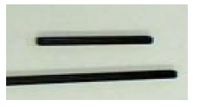
Question 4
What are these LEGO parts called?
Bricks
Pegs
Axles
Bushings

Slide 13
Correct!
☺

Slide 14
Oops!
Read the possible answers carefully. How many of them are true?
Think about your answer.

Slide 15
Question 5
What is the function of a loop?
It makes a program shorter
It allows you to repeat statements
It saves on typing
All of the above

Slide 16
Correct!
☺

Slide 17
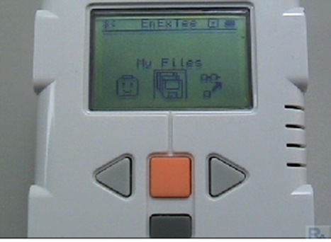
Oops!
‘My Files’ is highlighted, so all you need to do is press the orange button!

Slide 18
Question 6
Which button would you use to open ‘My Files’?
a)Left arrow
b) Right arrow
c) Either left or right arrow
d) Gray Button
e) Orange button

Slide 19
Correct!
☺

Slide 20
Oops!
It’s a threshold.
A threshold divides the readings into two categories.
In a light sensor, these are light and dark.
For a sound sensor, these are loud and soft.

Slide 21
Question 7
Susie is writing a line follow program.
She measure the light sensor reading on the black line, and the reading on the white background. She finds the average of these values. This is called :
An interface c) A work envelope
A threshold d) An inverse

Slide 22
Correct!
☺

Slide 23
Oops!
Remember that it turned LEFT from position A to get to position B.

Slide 24
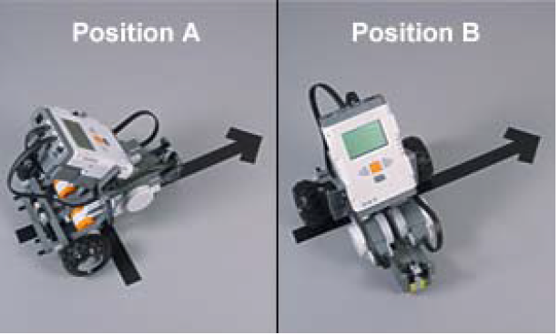
Question 8
Suppose this robot turned to its left to reach position B. What fraction of a full turn did it make to get from A to B?
One full turn
Three quarters of a turn
Half a turn
A quarter of a turn

Slide 25
Correct!
☺

Slide 26
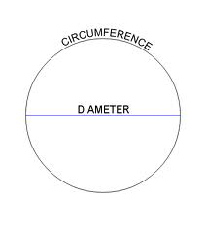
Oops!
Remember that one rotation is one circumference.
Remember that circumference is
Pi times = diameter
http://commons.wikimedia.org/wiki/File:Circle_diameter_circumference.svg

Slide 27
Question 9
One full turn of the robot’s wheel will move the robot:
One rotation
One circumference’s distance
Pi times diameter
All of (a) through (c)
None of (a) through (c)

Slide 28
Correct!
☺

Slide 29
Oops!
Are you sure? Take a look at some programs you have written.

Slide 30
Question 10
Predict what the robot will do when this program is run:
The robot will move forward, then stop after the last motor block
The robot will not move, because the gear blocks are not put in order
The robot will not move because there is no Wait block between commands

Slide 31
Correct!
☺

Slide 32
Oops!
Think about when you were standing with your feet on either side of the line.
If you were following the left side of the line, you would turn right when you saw white on your left.
If you were following the right side of the line, you would turn left when you saw white on your left.

Slide 33
Question 11
When running the Line Follow program, your program is exactly the same no matter whether you are tracking the left or the right side of the black line.
True
False

Slide 34
Correct!
☺

Slide 35
Oops!
Remember, you add the two readings and divide by two!
You are finding the average, or mean.

Slide 36
Question 12
When you calibrate the light sensor, the dark reading is 30 and the light reading is 50. What will your threshold be?
80
40
30
20

Slide 37
Correct!
☺

Slide 38
Oops!
Below the threshold will be a darker value!

Slide 39
Question 13
If your threshold is 45, would a reading of 53 be counted as dark or light?
Dark
Light

Slide 40
Correct!
☺

Slide 41
Oops!
The robot will go fastest if it has a bigger gear on the driving gear (on the motor) and a smaller gear on the driven gear (on the wheel)

Slide 42
Question 14
Katrina has a box of 8-tooth gears and a box of 16-tooth gears in her workshop. What combination of these gears on motor and wheel will make the fastest-moving robot on a flat, clear surface with nothing being pushed?
The 16-tooth gears should go on the motors and drive 16-tooth gears on the wheels.
b) The 16-tooth gears should go on the motors and drive 8-tooth gears on the wheels.
c) The 8-tooth gears should go on the motors and drive 8-tooth gears on the wheels.
d) The 8-tooth gears should go on the motors and drive 16-tooth gears on the wheels.

Slide 43
Correct!
☺

Slide 44
Oops!
Gear ratio is calculated as
Driven gear / driving gear
Or driven gear : driving gear

Slide 45
Question 15
How do you calculate the gear ratio?
a) Driving gear / Driven gear
b) Driven gear / Driving Gear
c) A ratio of the gear teeth to the motor power
d) Driving gear teeth / number of gears

Slide 46
Correct!
☺

Slide 47
Oops!
It’s driving, so it’s attached to the motor.

Slide 48
Question 16
The driving gear is
Attached to the wheel
Attached to the motor
Attached to another gear
The steering wheel

Slide 49
Correct!
☺

Slide 50
Congratulations!
Make sure that you have turned in your annotated program and final paragraph for the project.

