Slide 1
Rocks and the Rock Cycle

Slide 2
Igneous Rocks
Most rocks begin as this kind.
Formed from magma that has cooled.
Over time change due to weathering and erosion→ Become small fragments of rocks→ get carried away→ become sediment in beds→ Over time gets buried and gets cemented together→ forms Sedimentary Rocks

Slide 3
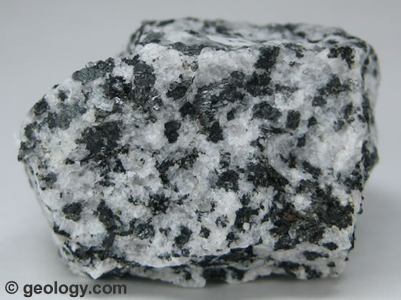
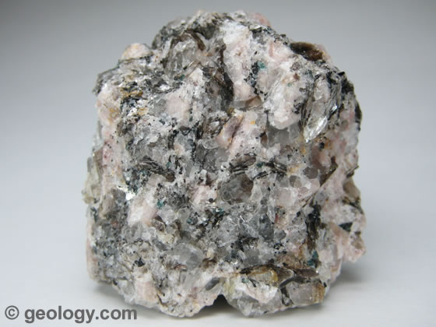
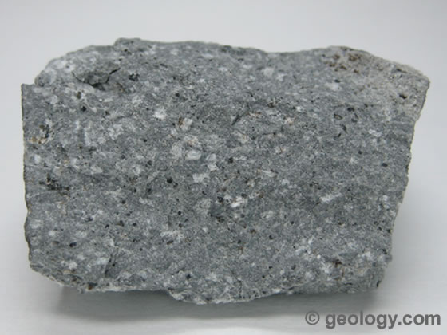

Slide 4
Sedimentary Rocks
Formed by the accumulation of sediment.
Formed due to great pressure and heat, with enough of these factors it will form something new.
Becomes metamorphic rock

Slide 5
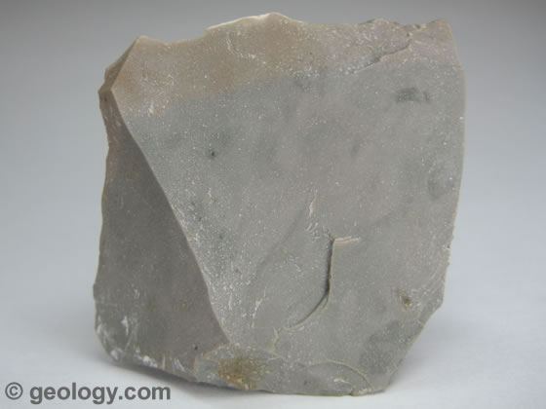
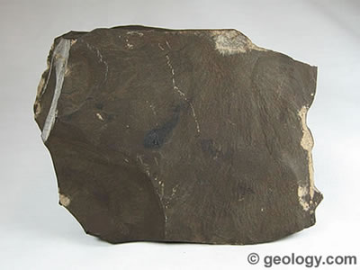
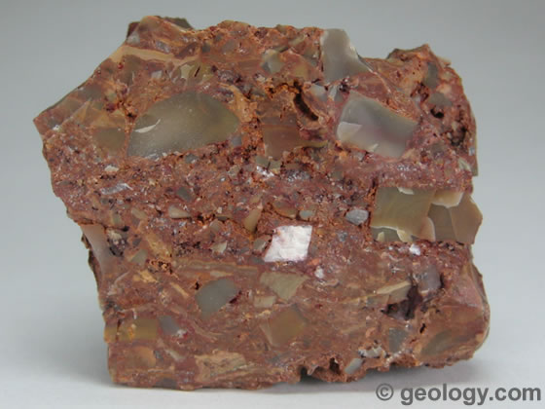
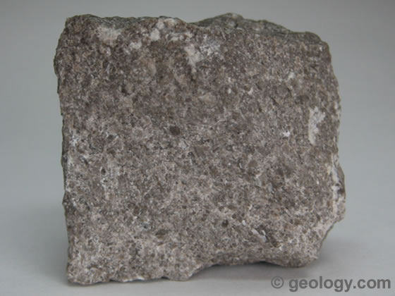

Slide 6
Metamorphic Rocks
Comes from sedimentary rock
Formed due to great pressure and heat cooking the sedimentary rock.
It can be eroded and weathered
If pushed deep into the earth it becomes magma, which becomes igneous rock.

Slide 7
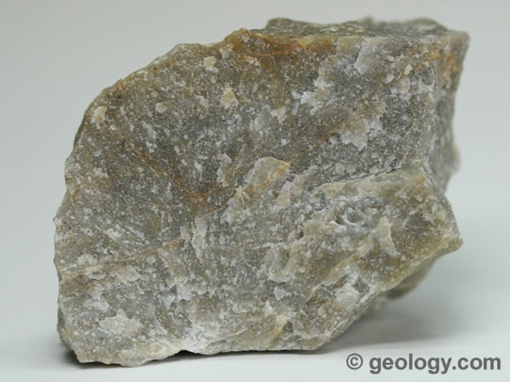
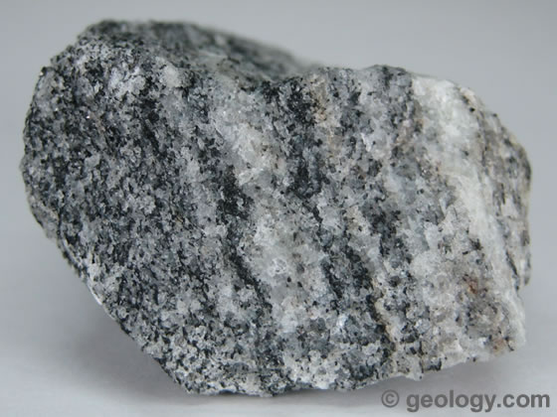
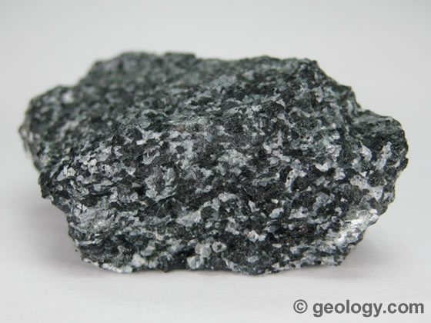
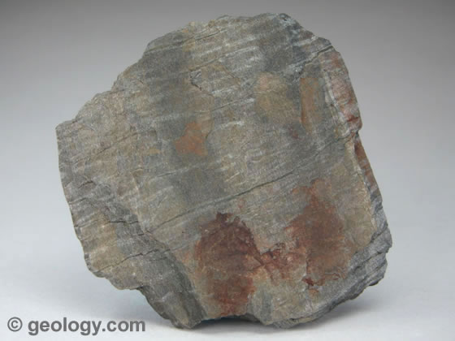

Slide 8
http://www.kidsgeo.com/geology-for-kids/0025B-rock-cycle.php

